Slide 1
SNAG 2021
RNAV
GNSS(GPS)/SBAS
LPV; LP; LNAV/VNAV; VNAV; RNP
PAPI; VASI

Slide 2
AC 90-100A in depth review
Area Navigation (RNAV)
GNSS
DME/DME
Flight Technical Error (FTE)
Position Estimation Error (PEE)
Just Kidding…….
A wealth of information but what do you really need to know?

Slide 3
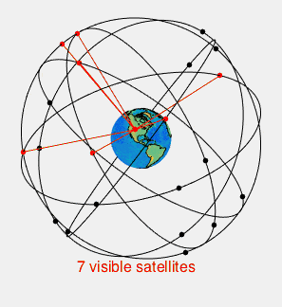
Global Positioning System
Signal Strength, or lack of
Easily jammed
Owned by the DoD
24 Satellite Constellation
Fewer visible at any time
Most units will monitor

Slide 4
Receiver Autonomous Integrity Monitoring
You may have heard of RAIM…
Yes it is still a thing
No you (mostly) don’t have to do anything special anymore
RAIM assesses the integrity of GPS
Uses redundant signals to produce several fixes to compare
Predicts GPS satellite location with respect to destination

Slide 5
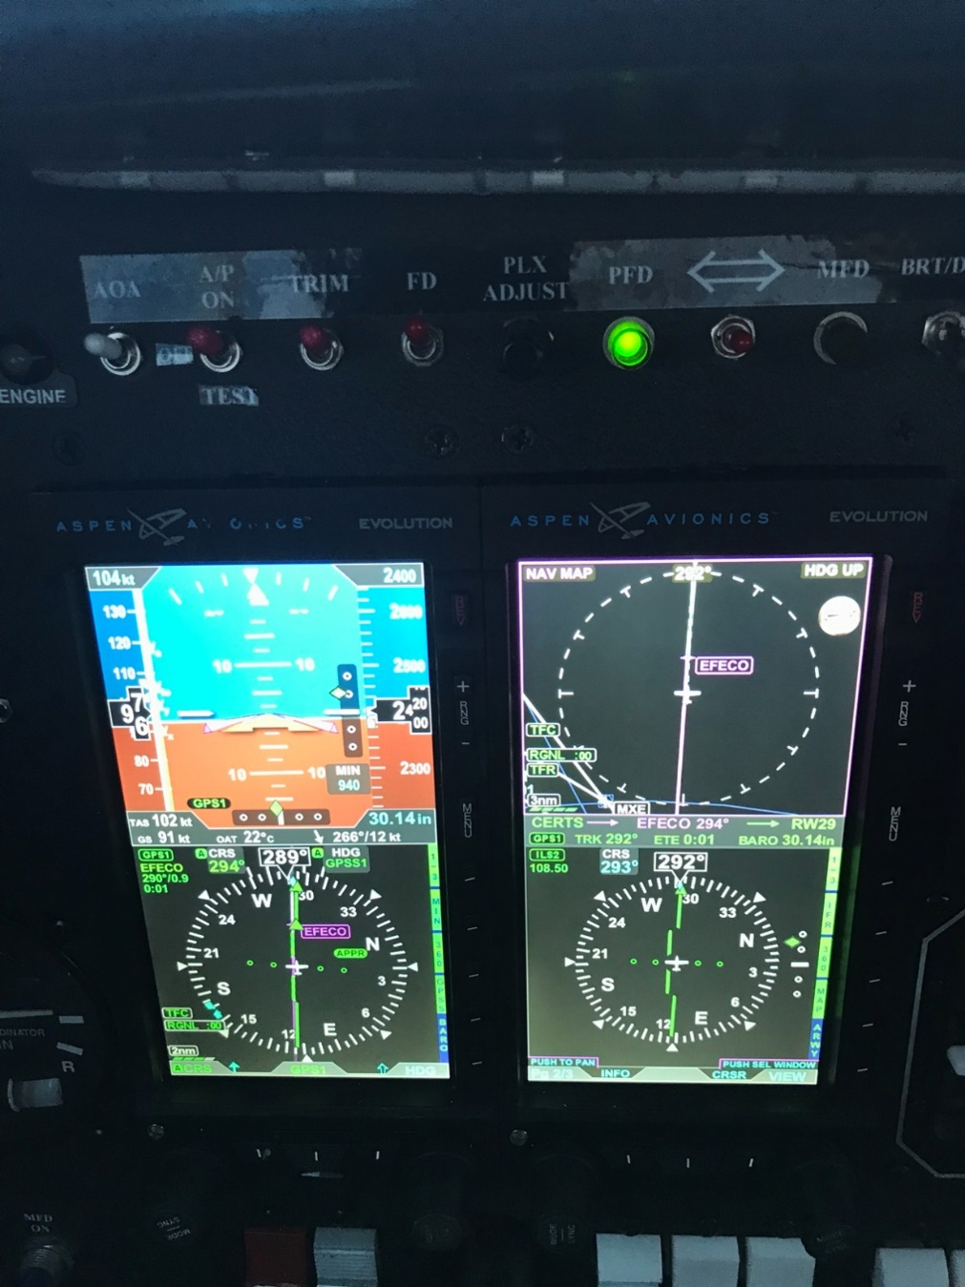
GPS Continued
Enroute >30nm CDI +- 5.0 nm
Terminal < 30nm CDI +- 1.0 nm
Approach at 2nm before Final Approach CDI +- 0.3 nm

Slide 6
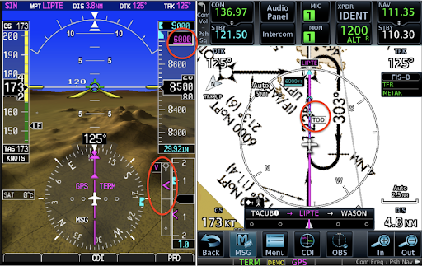
GPS

Slide 7
GPS and augmentation systems (SBAS)
Wide Area Augmentation System (WAAS)
European Geostationary Navigation Overlay Service (EGNOS)
GAGAN (India)
System for Differential Corrections and Monitoring (SDCM) (Russia)
BeiDou (BDSBAS) (China)
MSAS (Japan)
Just know there are other systems
Why do you care? LPV!

Slide 8
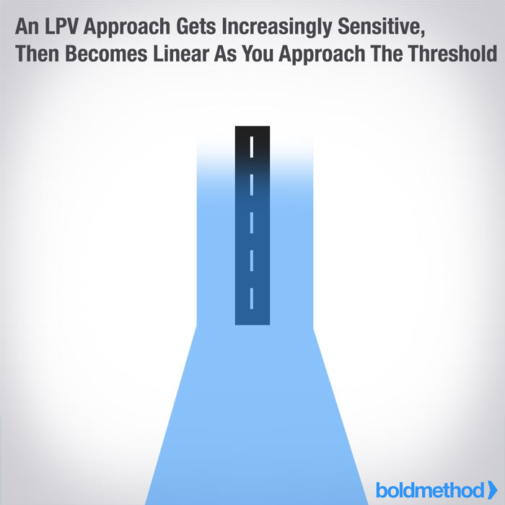
Localizer performance with vertical navigation
LPV basically a precision GPS approach
As low as 200 HAT
TERPS trapezoid funnels

Slide 9
LNAV/VNAV yes you need WAAS
NOT an LPV…
Rectangular TERPS trap.
Not necessarily higher than LPV
Still WAAS
Most units will give you the lowest available approach
Some will default to LPV
Know your unit…

Slide 10
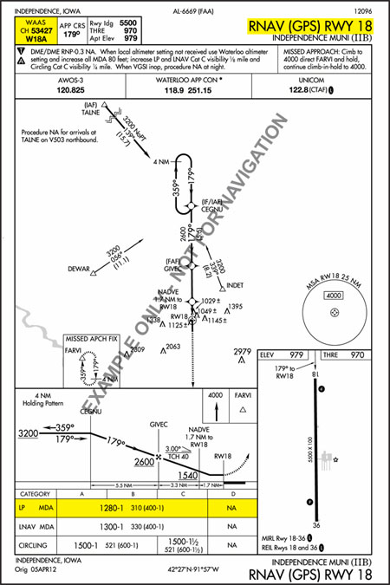
LP (Localizer performance)
STILL NEEDS WAAS but not a VNAV
Looks like a localizer
MIGHT CALCULATE STILL VERTICAL NAV

Slide 11
LNAV
Older
Like a LP but with a different trap due to different receiver capabilities
Does not require WAAS.
Your receiver still may calculate and display a GS (VDA)
How we inspect VDA

Slide 12
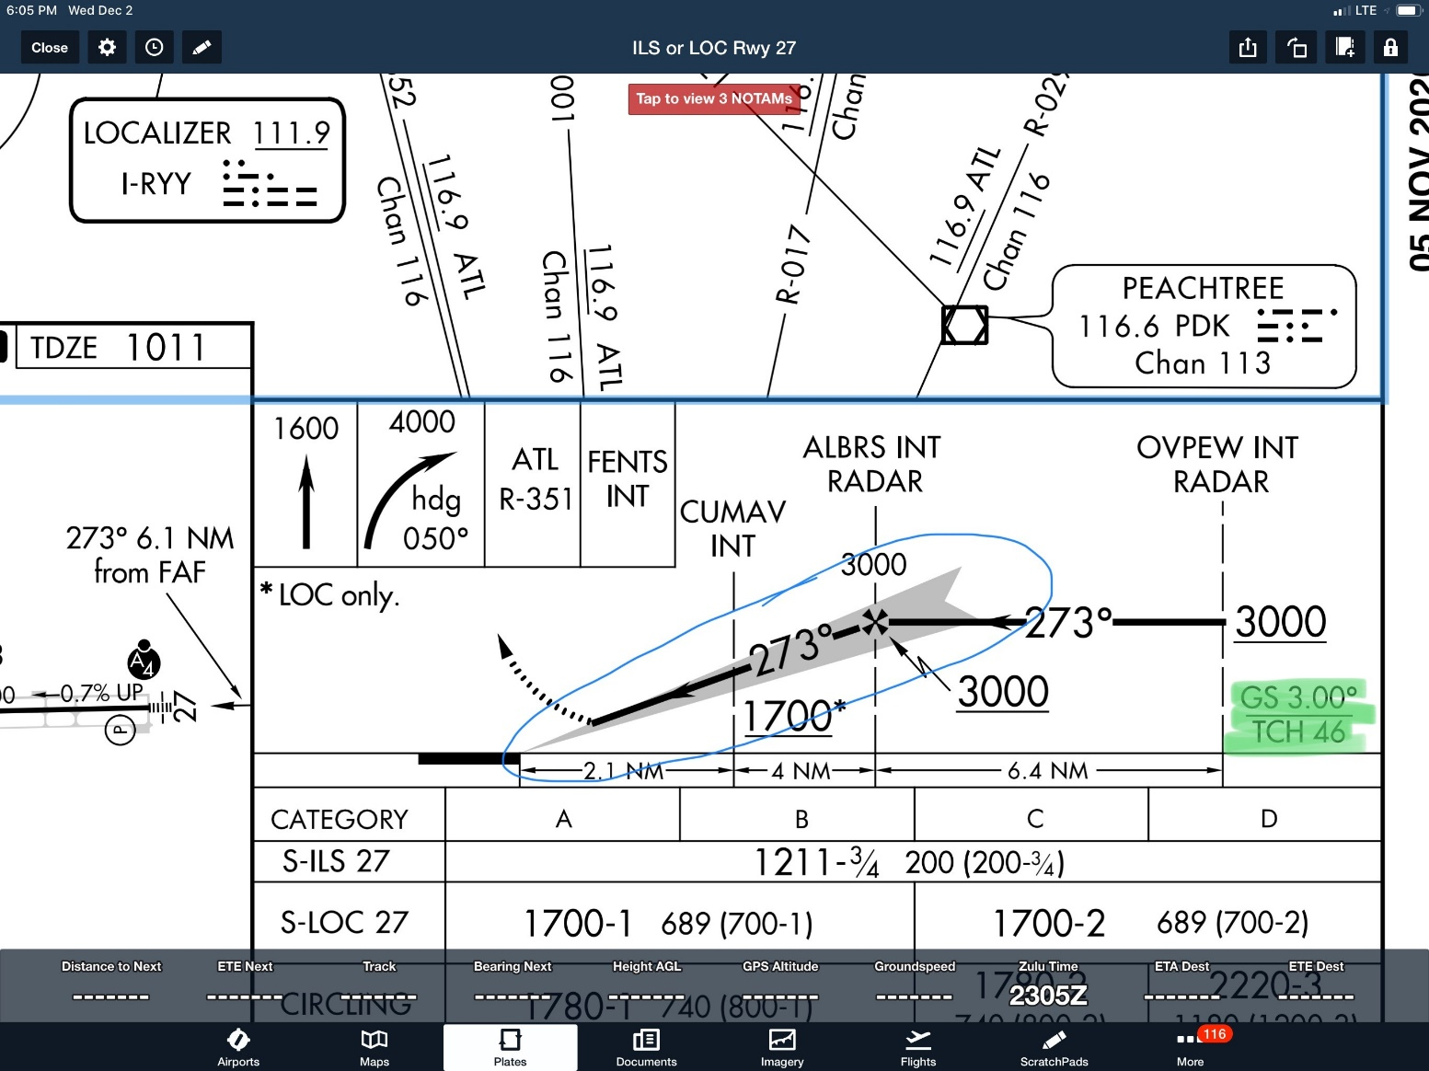
GS vs GP vs VDA

Slide 13
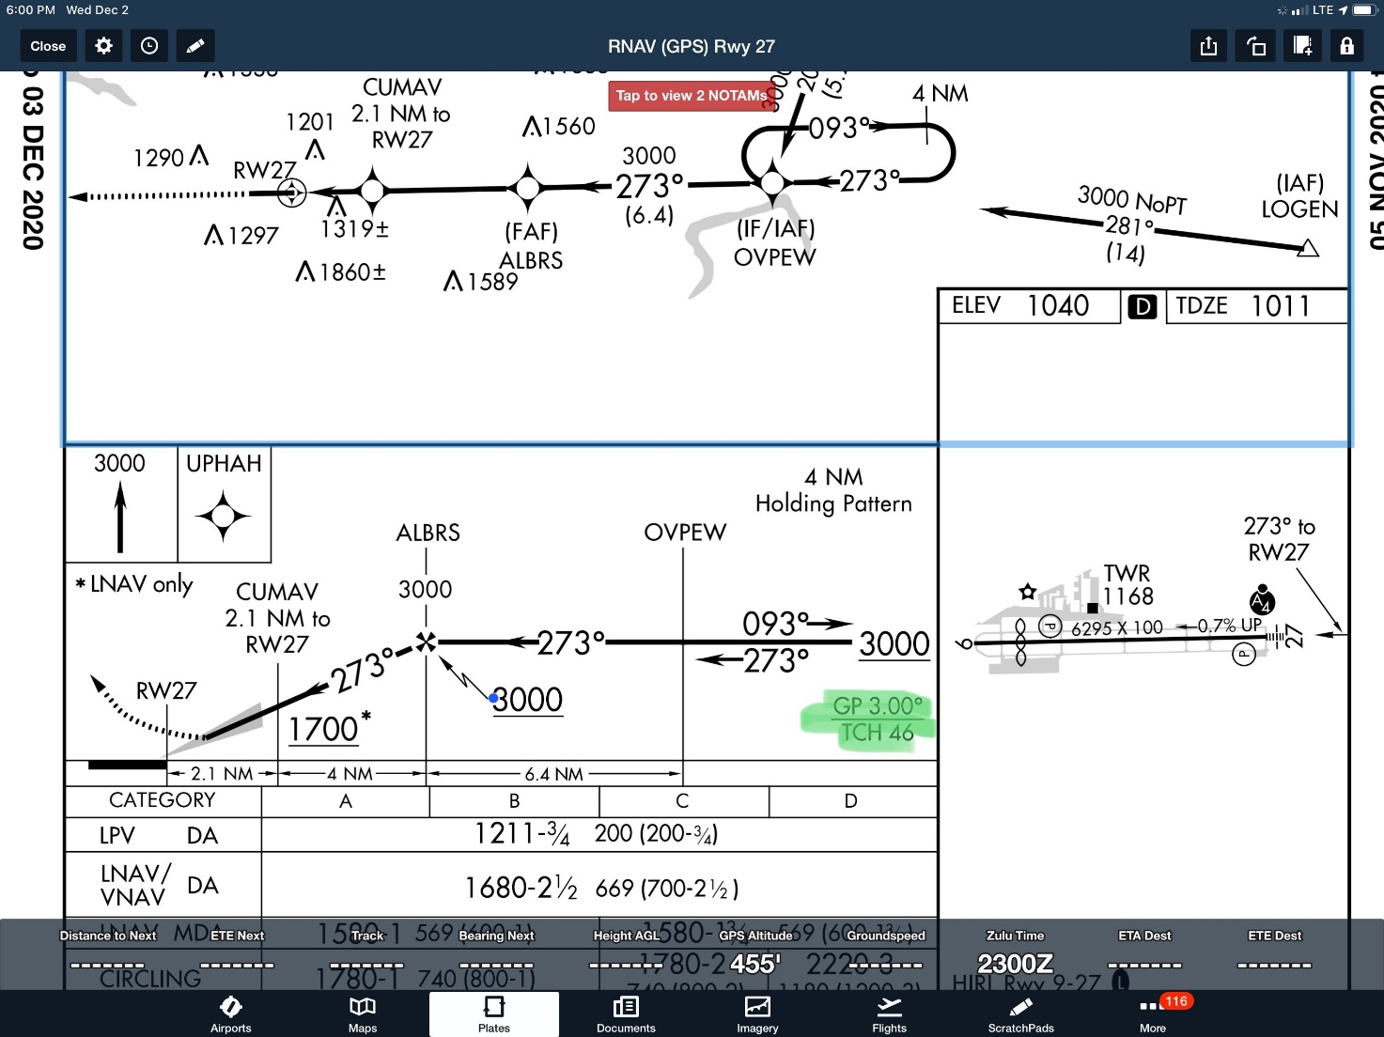
GP

Slide 14
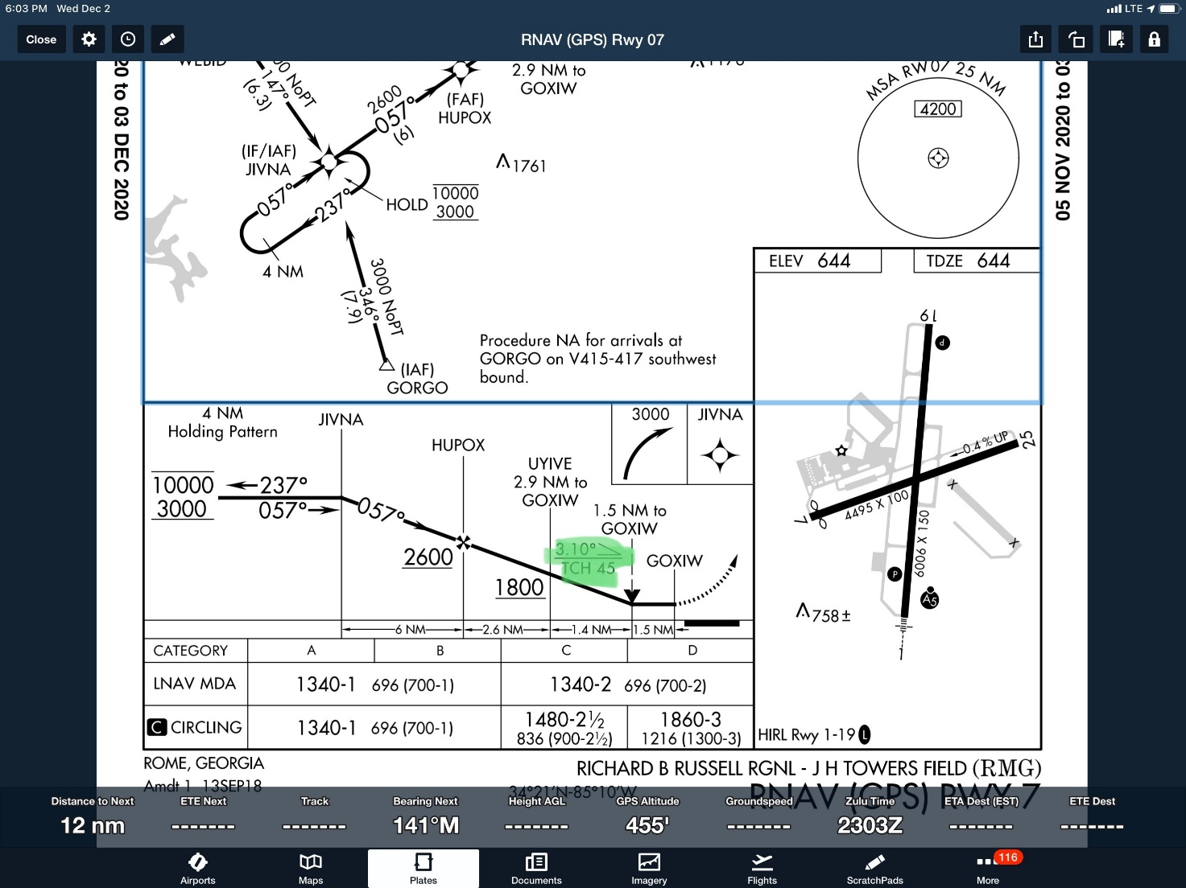
VDA

Slide 15
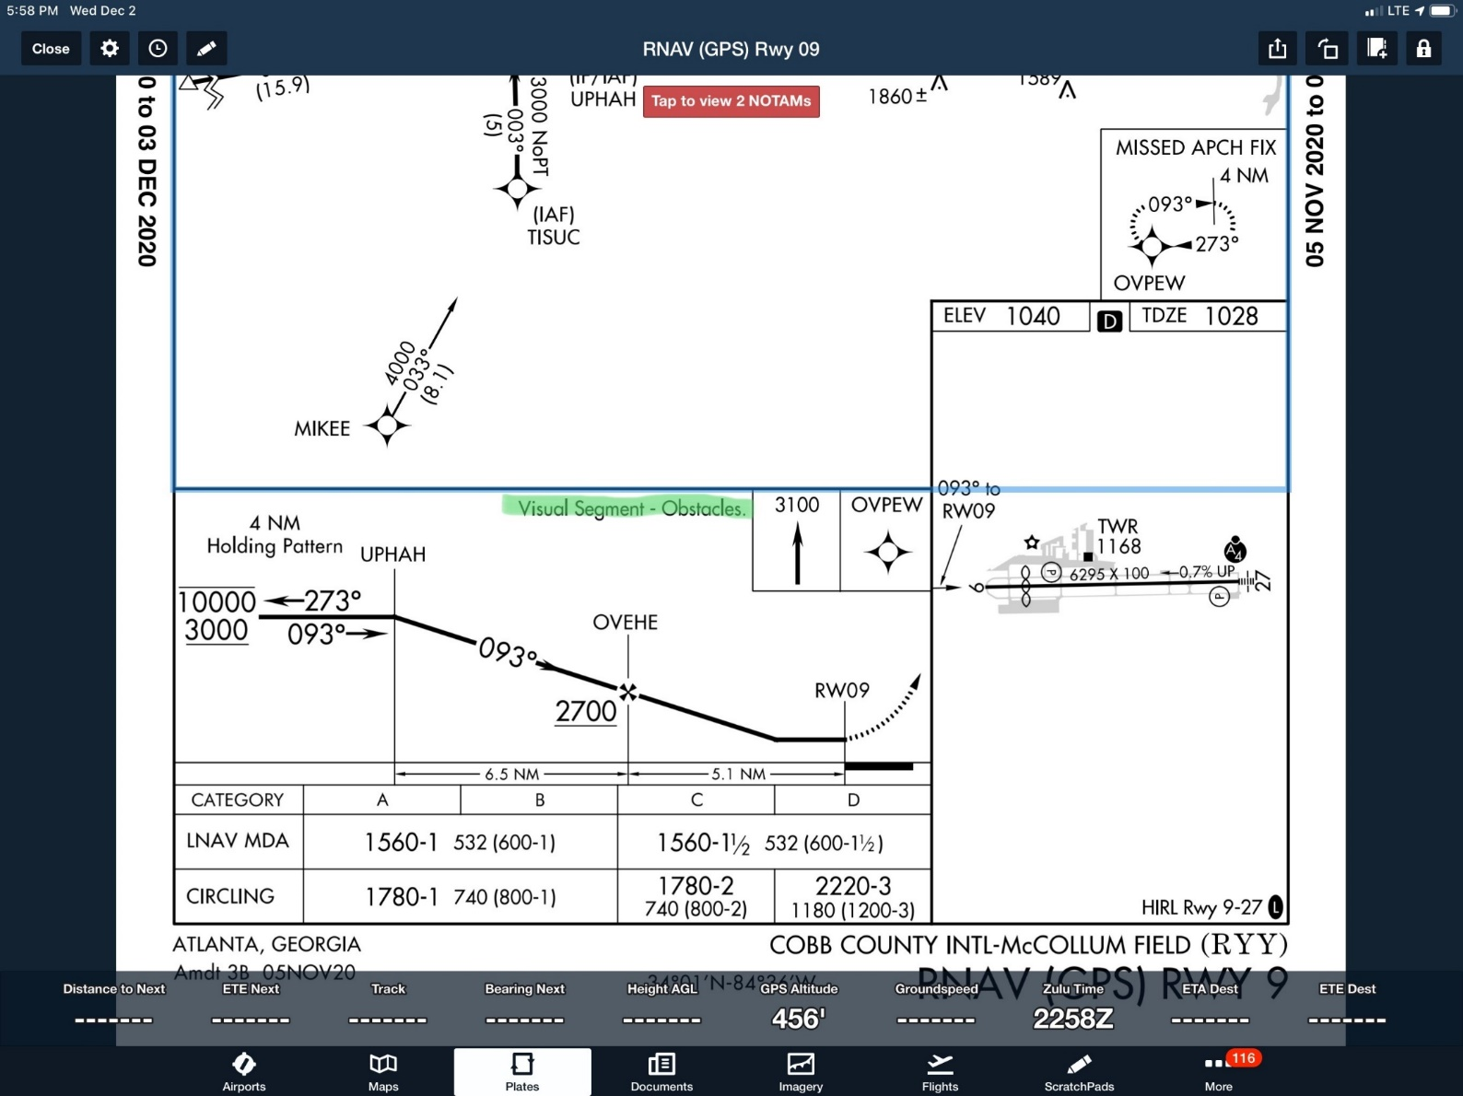
VDA Visual Segment Obstacles

Slide 16
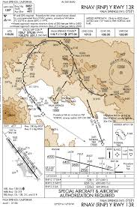
Required Navigational Performance (RNP)
Does anyone here fly RNP capable and approved aircraft?
RNP concept
RNP procedure design

Slide 17
I'm VFR only and I sat here this whole time
First, Thank you
What is in it for me?
Do you or will you have a GPS in your NAVION? It is still important to know what your equipment can do just like it is important to know what your aircraft can do.
VASI
PAPI

Slide 18
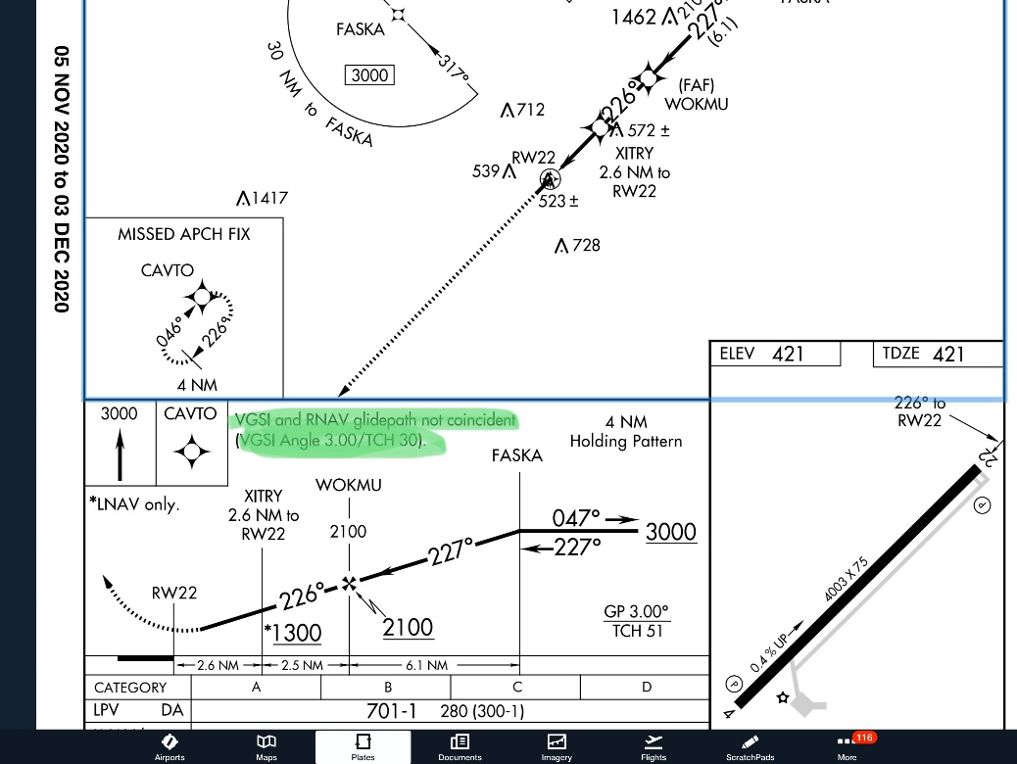
PAPI and VASI
Yes we flight check them
Yes you should report problems to the airport manager.
Coincident or not coincident
Clearance Below Path
Height Groups

Slide 19
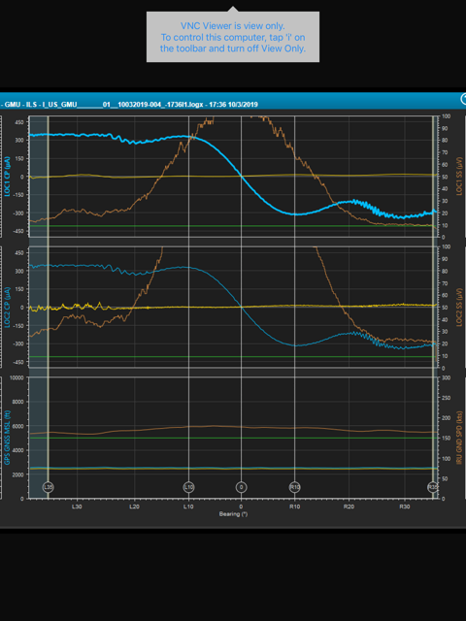
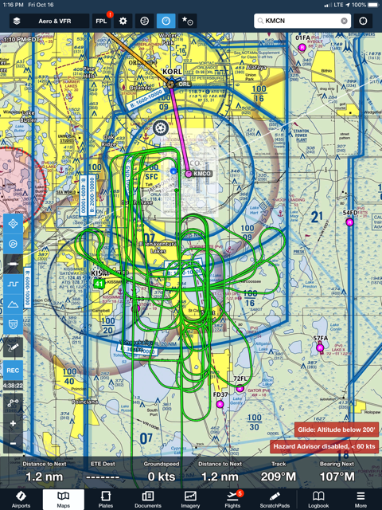
Questions?

Slide 20
Support
AC 90-100A
AC 90-105
AC 90-107
AIM
https://www.nstb.tc.faa.gov/
https://www.faasafety.gov/search/default.aspx?keywords=GPS+Jamming+Advisory&submit=Search
https://www.faasafety.gov/spans/noticeView.aspx?nid=11699

